Slide 1

Introduction
COMP4451 Game Programming

Slide 2
Overview
Motivation: Why Games?
Game Mechanics (Non-digital Games)
Digital Games: History
Digital Games: Category
Digital Games: Platform

Slide 3
Why work on games?
It’s one of biggest entertainment industries in the world. Huge potential market!
It’s fun! We love to play!
Recreational and social activity
Relaxing

Slide 4
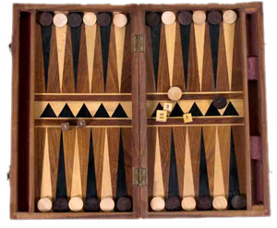
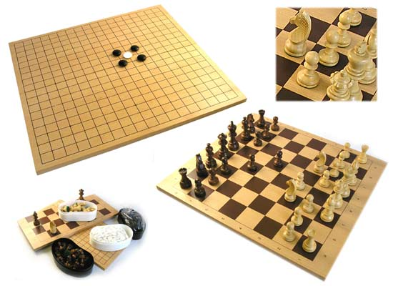
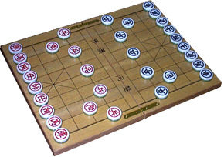
Gameplay: Everlasting Games
Go
Chess
Chinese Chess
Backgammon
Mah-jong
……

Slide 5
Characteristics
Simplicity: Simple rules and easy to learn
Complex Strategies
Unchanging: Play in the same (or similar) way over hundreds of years
Does not get boring

Slide 6
Game Mechanics: Progress
Game designers called “rules” as “game mechanics” ---
a system by which a game is progressed, for examples:
Luck
Strategy
Diplomacy
Resource Management
Territory Control
Note: These also apply to computer games!

Slide 7
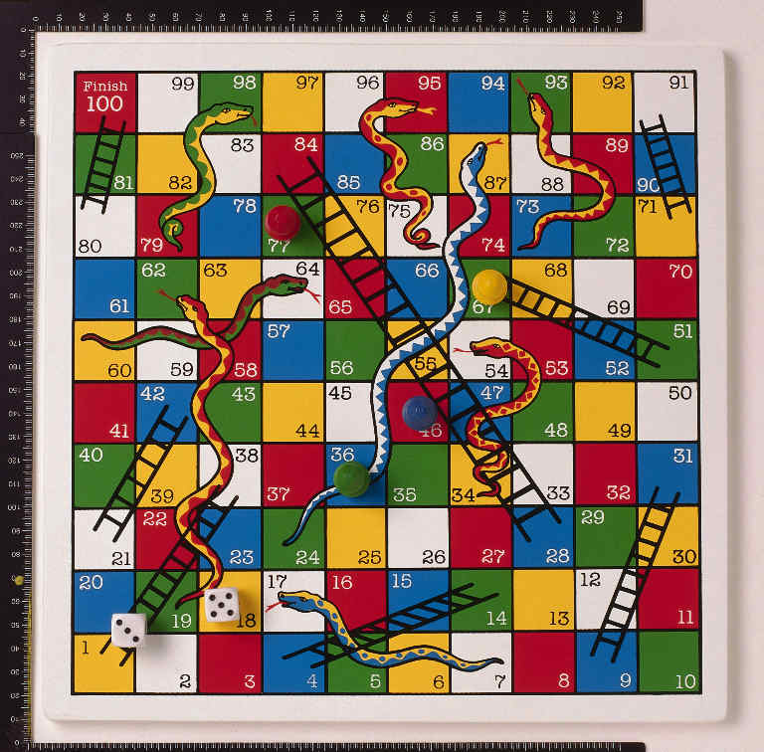
Game Mechanics: Progress
Luck:
Random Chance
Player has no control, e.g., rolling a dice, drawing a card, etc.
Example: Snakes and ladders

Slide 8
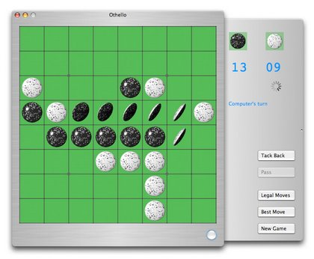
Game Mechanics: Progress
Strategy:
Opposite of luck
A player’s ability to plan the turns and moves within a game determines the outcome
Examples: chess and variants

Slide 9
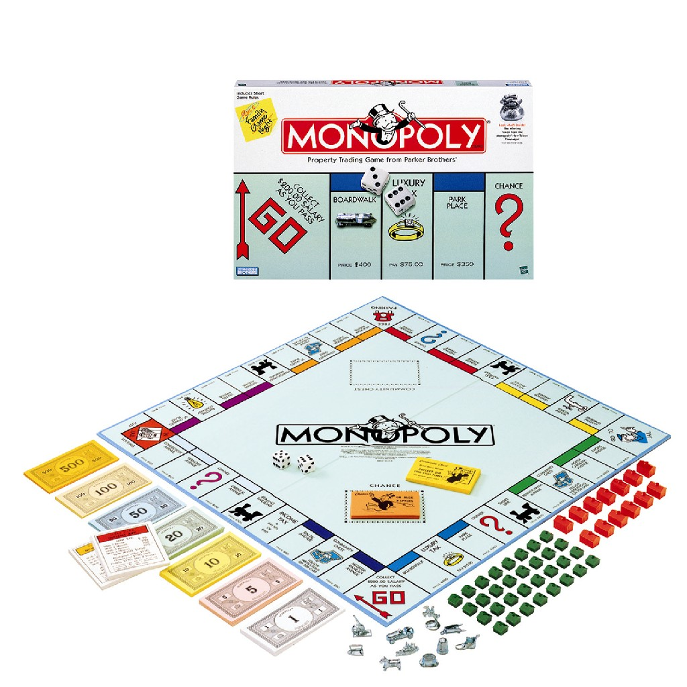
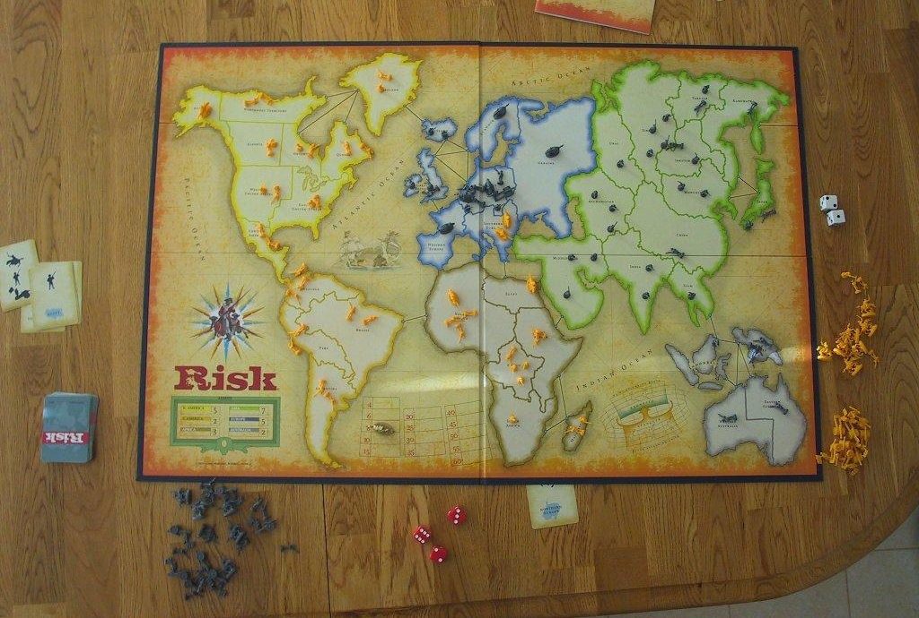
Game Mechanics: Progress
Diplomacy:
This refers to how players interact – do they collaborate and help each other?
At what point should they stop and play on their own?
Examples: Monopoly, Risk, etc.

Slide 10
Game Mechanics: Progress
Resource Management:
A player has a certain amount of assets, which much be used carefully if he/she is to win
E.g., money in Monopoly, army in Risk, etc.
A player who spends them too quickly may be unable to act later. Saving them up too long might cause a player to miss a chance.

Slide 11

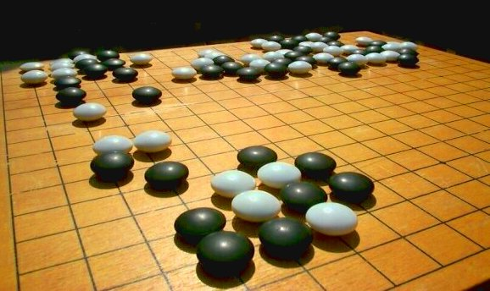
Game Mechanics: Progress
Territory Control:
Control of the game space is also important
A player should protect and develop the areas he/she owns, while his/her opponent is doing the same thing
Examples: Go, Monopoly, Reversi (Othello), Risk, etc.

Slide 12
Game Mechanics: Game Design
Struggle to find a balance for the elements below
in your game design:
Luck
Strategy
Diplomacy
Resource Management
Territory Control
For example, a game that purely relies on luck could be boring

Slide 13
Game Mechanics: Goals/Rewards
Ancient games or non-digital games usually have
definitive goals, e.g.,
Eliminating the other player(s) from the game,
e.g., Monopoly , etc.
Achieving a pre-defined target, e.g., Risk , etc.
Winning a race, e.g., Snakes and ladders, etc.
Occupying most of the game space, e.g., Go, Othello, etc.

Slide 14
Game Mechanics: Goals/Rewards
Modern (digital and non-digital) games may not rely
on winning a definitive goal:
For examples, RPG games, online games, etc.
Rather, it gives players challenges and players receive an enjoyable experience in the gameplay

Slide 15
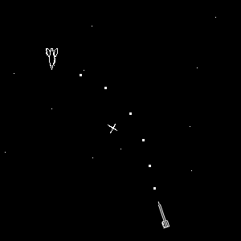
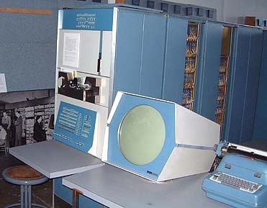

Digital Games History: Dawn
1951 : Marufuku, a japanese playing
card manufacturing company,
changed its name to Nintendo
http://www.nintendo.com/corp/history.jsp
1961: MIT student Steve Russell
created Spacewar, the
first interactive computer
game; its platform:
a DEC PDP-1

Slide 16
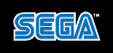
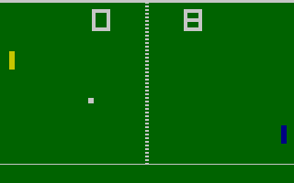
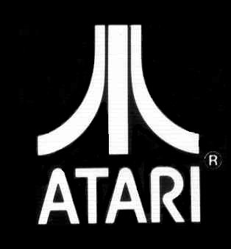
Digital Games History: Coin-Op
1964 : Rosen Enterprise merged
with Service Games to form
Sega Enterprise
1972:Bushnell, who designed
Computer Space (1st arcade
game) formed Atari
Their first product “Pong”
– simulate ping-pong game
https://www.youtube.com/watch?v=e4VRgY3tkh0

Slide 17
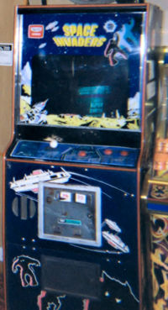
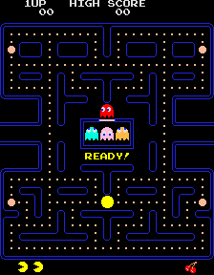
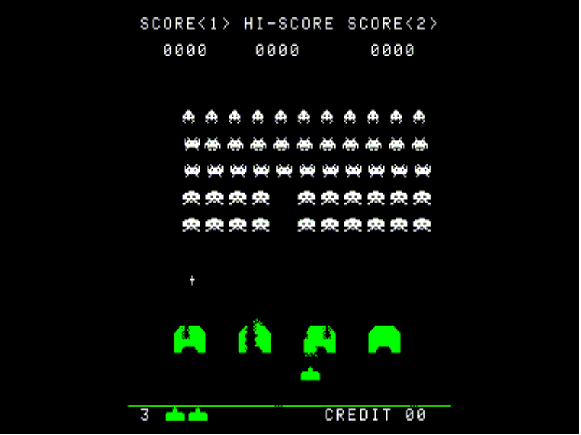
Digital Games History: Coin-Op
1973: Taito, Midway entered the business
1975: Namco started making games
1978: Midway shiped Space Invaders
1979: Namco released Pac-man
We refer it as the age of
Arcade (coin-op) games.
Note: An arcade game is
a coin-operated
entertainment machine
https://www.youtube.com/watch?v=MU4psw3ccUI
https://www.youtube.com/watch?v=OerJeu3wE5k

Slide 18
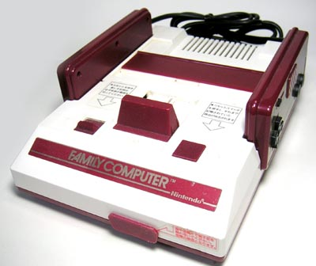
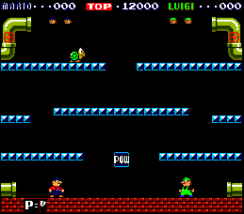
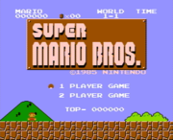
Digital Games History: Home
1980: Atari releases Space
Invaders (selling home versions
of arcade hits)
1983: Nintendo test-markets
the Famicom in New York as
Nintendo Entertainment
System (NES):
- Mario Bros: 1983,
- Super Mario Bros.: 1985
https://www.youtube.com/watch?v=ly8DofqCuOs

Slide 19
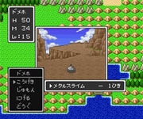
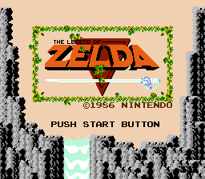
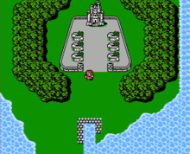
Digital Games History: Home
Dragon Quest I
Classic RPG Games (Home Entertainment)
More NES Games (Japan):
1985: Dragon Quest / Dragon Warrior
1986: Legend of Zelda
1987: SquareSoft published
Final Fantasy (first
version)
Final Fantasy

Slide 20
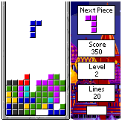
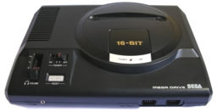
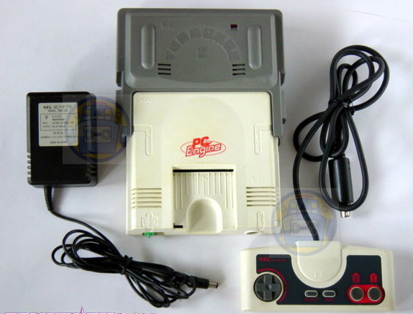
Digital Games History: Home
1985: Russian mathematician
Alex Pajitnov designed Tetris
(running on PC)
1987: NEC released the PC-engine
game console in Japan
1988: Sega released the
16-bit Mega Drive
PC Engine
Mega Drive

Slide 21
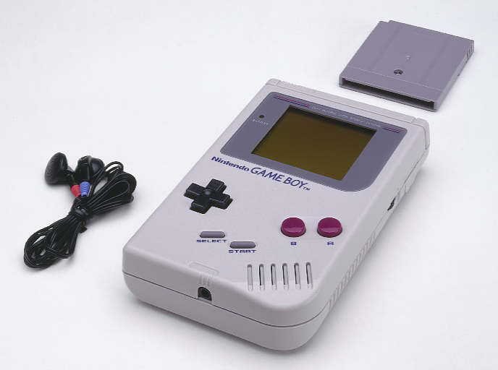
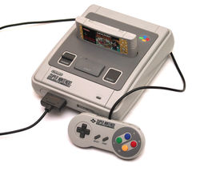
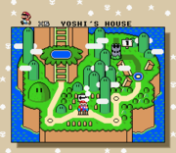
Digital Games History: Home
1988: Nintendo released Game Boy worldwide (Handheld
game console), >110 million were sold up to 2000.
1990: Nintendo later released 16-bit Super NES (SNES)
Classic game: Mario Super World

Slide 22
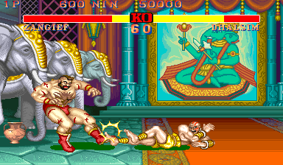
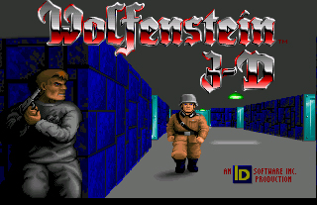
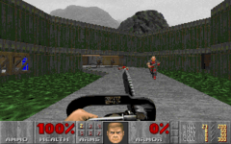
Digital Games History: Home
1991: Capcom released the arcade
game Street Fighter II, later moved
to PC and Console game markets
1992/1993: Id Software published
Wolf3D and Doom for PCs:
Defines 3D FPS game
(FPS = First Person Shooting)
Allows two players connect
head to head over the
phone lines (Deathmatch)
DOOM
Wolf3D
https://www.youtube.com/watch?v=WWbP851-0yI

Slide 23
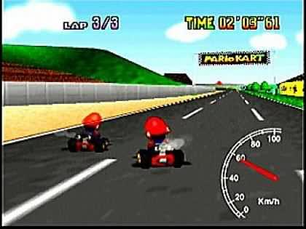
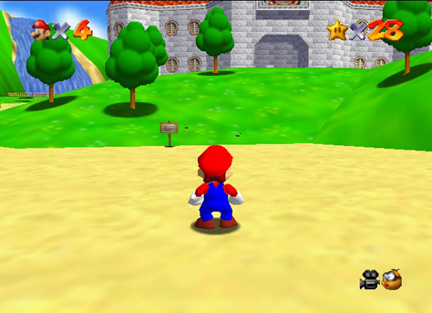
Digital Games History: Home
Furious competition began
1996: Nintendo 64 launched (Super Mario 64)

Slide 24
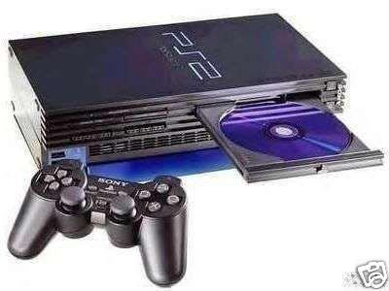
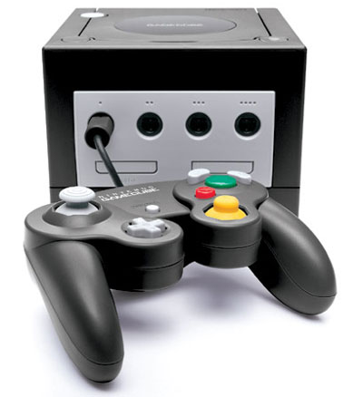
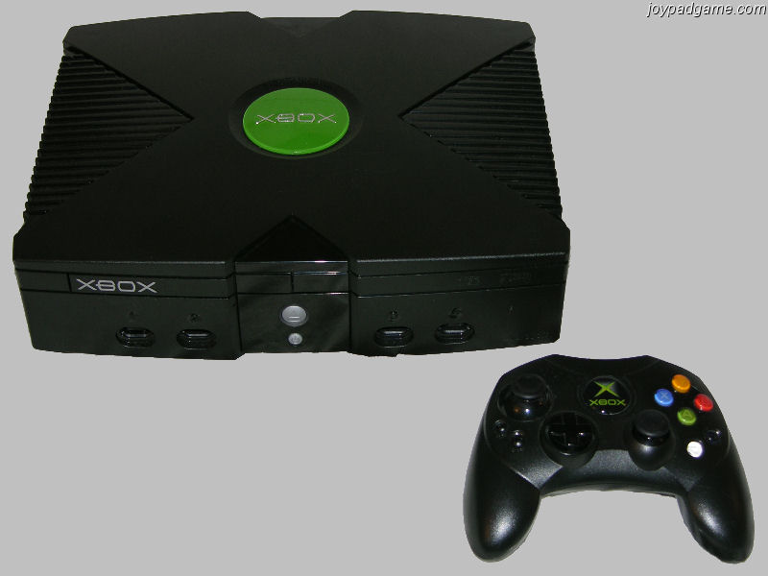
Digital Games History: Home
2000: Sony released PlayStation 2 in Japan
2001: Nintendo released GameCube
Microsoft released Xbox (Nvidia Graphics Chip)

Slide 25
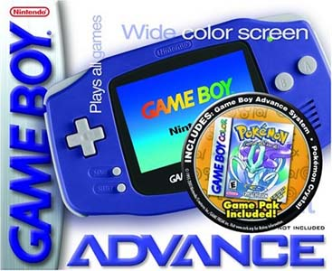
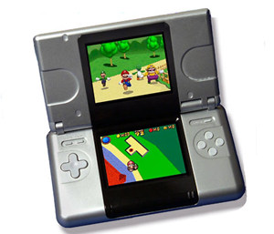
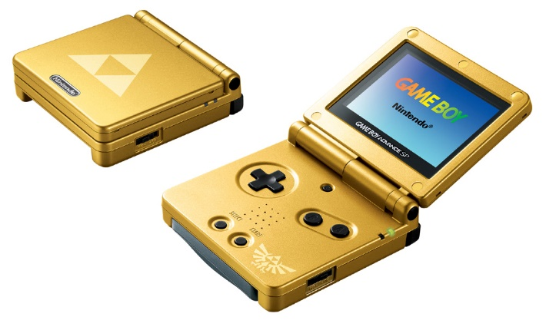
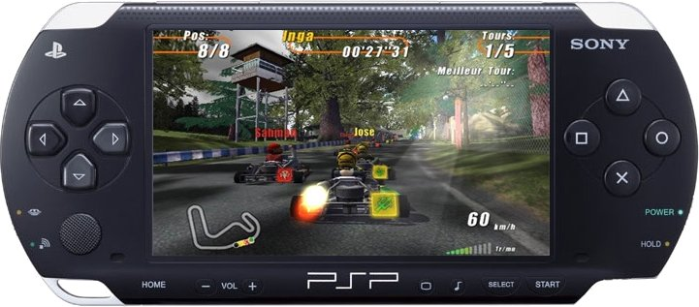
Digital Games History: Home
2001: Nintendo launched Game Boy Advance
2004: Nintendo launched dual screen NDS
(portable); wireless multiplayer and touch screen
control; Sony released PlayStation Portable (PSP)
Since 2006: Your phone!
Game Boy Advance
Game Boy Advance SP
NDS

Slide 26
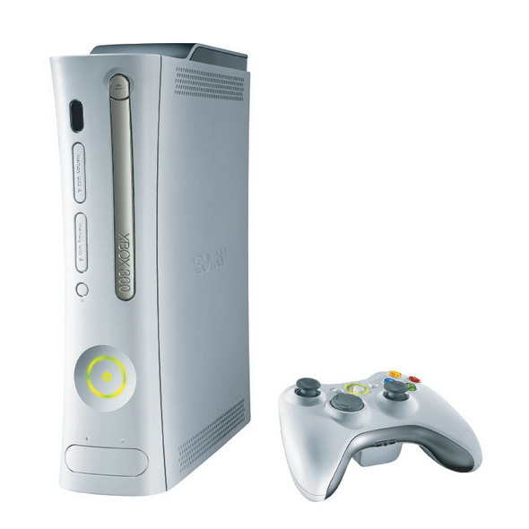
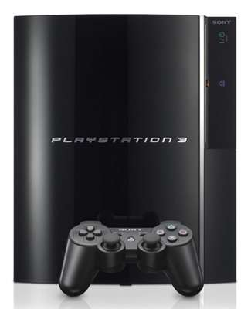
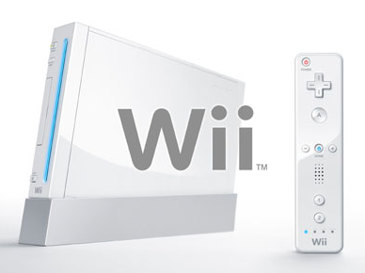
Digital Games History: Home
Big three:
2005: Microsoft – XBox360
2006: Sony - PlayStation 3 (PS3)
2007: Nintendo – Wii (http://en.wikipedia.org/wiki/Wii_Remote)

Slide 27
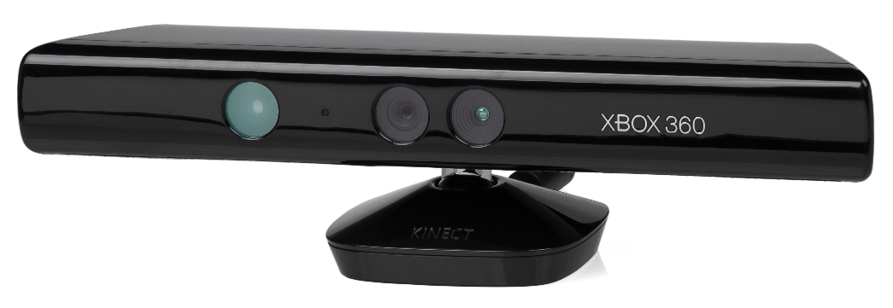
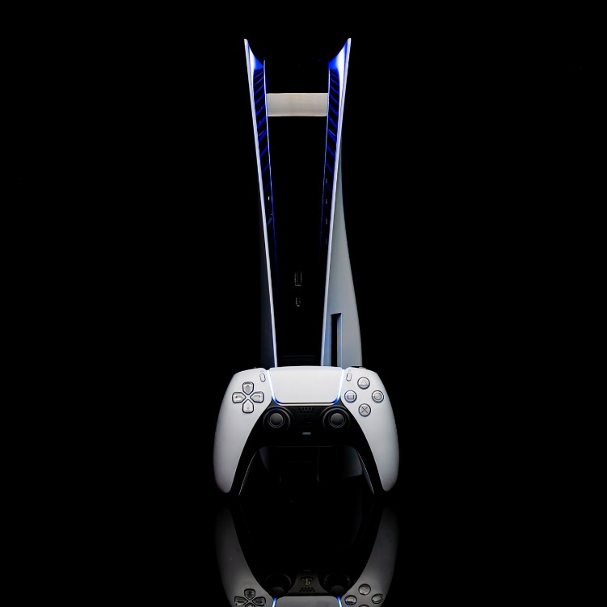
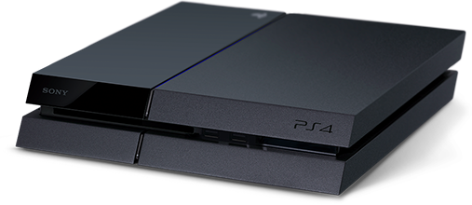
Digital Games History: Home
PlayStation 5
Xbox + Kinect
PlayStation 4

Slide 28
Digital Games History: The Trend
Color and resolution: from Monochrome to True Color
Graphics: from 2D to 3D or 3D effects
Portability: from Home to Travel
User control: from Joypads, to Touch screen control,
to Motion-sensitive control in Wii, to vision on Kinect
Player: from single-player, to multi-player with multiple
joypads, to multi-players through wireless or internet
Game space: from virtual to real world (Wii and Kinect)
What’s next? More VR? More mobile?

Slide 29
Digital Games Category
Action
Adventure
Strategy (real-time or turn-based)
Role Playing Games
Simulation
Sports Games
God Games
Puzzle Games
Online Games
Others
Mixed?

Slide 30
Action
Destroy the enemies
Mostly:
Shooting games
Fighting games
Platform games
Space Invaders (1978)

Slide 31
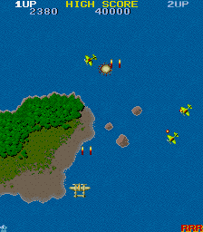
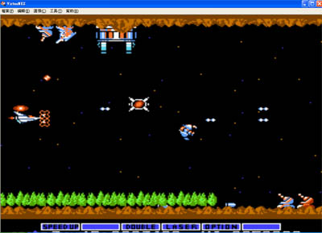
Street Fighter II (1992)
1942 (1985 NES)
Salamander (1986 Konami)
Wolf 3D (1992)
Doom (1993)

Slide 32
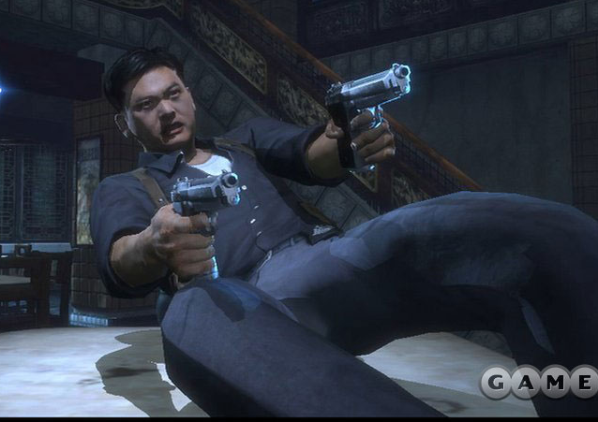
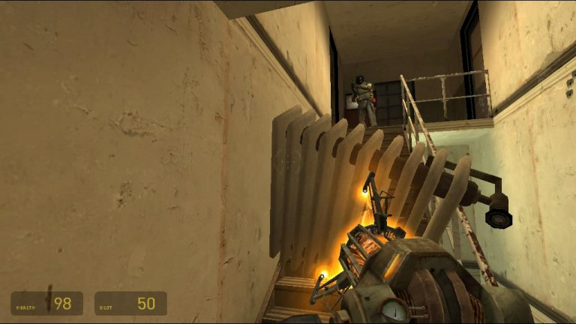
Half Life 2 (2004)
Stranglehold (2006)

Slide 33



Action: Platform Games characterized by jumping to and from suspended platforms or over obstacles.
Prince of Persia (1989)
Donkey Kong (1981)
Super Mario Bros. (1985)

Slide 34


Adventure
Characterized by investigation,
puzzle solving and exploration
of unknown area
Focus on narrative rather
than reflex-based challenges
Indiana Jones and the Fate
of Atlantis - LucasArts (1992)
The Secret of Monkey Island
– Lucas Arts (1990)

Slide 35

Action and Adventure
Puzzle solving in
action framework
GTA series

Slide 36
Strategy
The players' decision-making skills
have a high significance in determining
the outcome
Manipulating a number of entities
to achieve certain goals
Real-time involves more fast pace
game play whereas turn-based
involve more thinking & planning

Slide 37


Realtime Strategy
Starcraft (1998) - Blizzard
Warcraft (1994) - Blizzard

Slide 38


Realtime Strategy
Command & Conquer 3 :
Tiberium War (2007)
Starcraft II (2008)

Slide 39

Role-Playing Games
Original pen-and-paper game (Advanced Dungeons & Dragons)
Configurable player characters improve with experience
Level, Skill, Weapon, etc.
Strong storylines
Dragon Quest (1985)
Final Fantasy (1987)
Land of Ys I (1987)

Slide 40


PAL (仙劍奇俠傳) (1995 DOS)
(Softstar, Taiwan)
Final Fantasy XII (2007)

Slide 41

Simulation
Vehicle simulation: OutRun 2
Can be further classified
into vehicle simulation
and construction &
management simulation
A mixture of skill,
chance, and strategy
to simulate an aspect of
reality

Slide 42


Construction & management simulation
Sim City (first release: 1989)
Civilization IV (2005)

Slide 43


Sports
Simulates the playing of traditional sports
Basketball, soccer, tennis, baseball, golf, boxing, bowling, etc.
NBA Live series
Winning Eleven series

Slide 44


Puzzles
Emphasize puzzle solving
Involves logic, strategy, pattern recognition, sequence solving,
word completion, or, in some cases, just pure luck.
Minesweeper (1973)
Lode runner (1983)
Tetris (1985)

Slide 45



Lemmings (1989 Game Boy)
Boxxle (1989 Game Boy)
Bust-A-Move (1994 SNES)

Slide 46
God game (Artificial Life)
The player is in a position with divine or supernatural powers
to maintain & grow a population of organisms, each of
which is unique
The player can affect the world and influence his/her subjects
but not directly control them (usually)
With some exceptions, God games tend toward large scales
The player’s view is an elevated, aloft (“God-like")
perspective
Usually, the player does not win or lose, but is challenged
to attain and maintain a level of success

Slide 47




Utopia (1982) – First god game
Populous (1989)
The Sims series

Slide 48
Online Games
Massively multiplayer online game (MMOG)
MMORPG: Massively multiplayer online role-playing game
e.g., Ultima online (1997), Diablo II (2000), Final Fantasy XI (2002)
MMOFPS: Massively multiplayer online first-person shooter
e.g., World War II Online (2001)
MMORTS: Massively multiplayer online real-time strategy
e.g., Starcraft (1998)
MMODG: Massively Multiplayer online dance game
e.g., DANCE! Online (2007)
Players can live, work & socializing in a virtual world
simultaneously through the Internet

Slide 49

Ultima Online (1989)
Starcraft (1998)

Slide 50





Others
Chess games, e.g., Monopoly, chess, Risk, etc.
Card games, e.g., solitaire, etc.
Music games, e.g., dancing, guitar, drum, etc.
Cooking games
Educational games

Slide 51
Digital Games: Platforms
1. Arcade games
2. Consoles
– Playstation, Xbox, Wii
3. Personal Computers (PC)
4. Portable Specialized Devices
– GameBoy Advance, PSP
Mobile phones
VR devices

Slide 52

Platforms: 1. Arcade Games
Advantages
Well-defined configurations
Disadvantages
Being superceded (given up) by
other TV game consoles

Slide 53

Platforms: 2. Consoles
Advantages :
Fixed configuration => Ease of support
Huge markets of family entertainment
Disadvantages:
Limited controllers available, typically joypads
Problem of getting license from console vendor
Potentially complex programming model

Slide 54

Platforms: 3. PC
Advantages:
Can explore state-of-the-art technologies
Convenient development environment access
Disadvantages:
Difficult to support the wide variety in hardware configurations
(Memory, CPU, graphics board, operating system, etc.)

Slide 55
Platforms: 4. Portable Gaming Devices
Advantages:
Fixed configuration
Disadvantages:
Relatively low computing power and memory
Limited programming resources
Screen size and resolution

Slide 56


Platforms: 4. Mobile phones
Advantages:
Good tradeoff of portability and power
APIs that allow for support of both PC and mobile
Disadvantages:
Screen size
Support different hardware configurations

Slide 57

Platforms: 5. VR devices
Advantages:
Immersive 3D experience
Expressive UI
Disadvantages:
Single-user display (often isolating)
Still expensive

Slide 58
Summary
Motivation: Why Games?
Game Mechanics (Non-digital Games)
Digital Games: History
Digital Games: Category
Digital Games: Platforms

Slide 59
Summary
During Game design:
What kind of game? Category? Mixed?
What platform(s)?
Console, PC, mobile, etc.
What are the game mechanics:
Luck, strategy, diplomacy, etc.

Slide 60
"When a designer is asked how his game is going to make a difference, I hope he … talks about gameplay, fun and creativity – as opposed to an answer that simply focuses on how good it looks.“
– Sid Meier (Civilization, Railroad Tycoon, Pirates)

